Slide 1
Uterine Cervix
Dr Mohammadian

Slide 2
در بیماری مبتلا به SCC دهانه رحم با گسترش وسیع تومور به داخل رحم و فوندوس همراه با درگیری پارامتر چپ بر اساس MRI لگن ، تصمیم به هیسترکتومی پس از اتمام کمورادیوتراپی گرفته شده است .کدام گزینه صحیح است؟(بورد 1400)
الف)کمورادیوتراپی با دوز کامل و سپس رادیکال هیسترکتومی تیپ 3
ب)کمورادیوتراپی با کاهش 25% دوز براکی تراپی و هیسترکتومی تیپ 1
ج)انجام عمل جراحی ورتهایم بدون رادیوتراپی
د)کمورادیوتراپی قطعی تا توتال دوز 78 گری بدون براکی تراپی

Slide 3
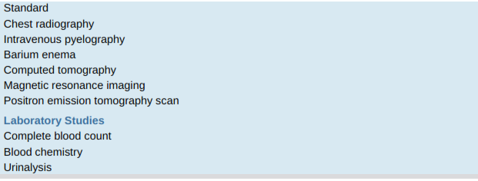

Slide 4
Laboratory Studies
For invasive carcinoma, patients should have the following laboratory studies:
complete peripheral blood evaluation, including hemogram , white blood cell count,and differential and platelet count;
Blood chemistry profile,with particular attention to blood urea nitrogen and creatinine;
liver function values;
And urinalysis.

Slide 5
Imaging Studies
In countries where 3D imaging is not routinely available, FIGO recommended evaluation for patients with cervical cancer includes a chest radiograph to assess for lung metastases and an IVP to determine whether hydronephrosis is present.
The IVP in many countries has been replaced by CT scan of the pelvis and abdomen with IV contrast material or by PET–CT scan.

Slide 6
Imaging Studies
In places where CT is not available, patients with stage IIB, III, and IVA diseases who have
Symptoms in the colon and rectum may benefit from a barium enema.
A skeletal survey may be performed to determine whether bone metastases are present.

Slide 7
Imaging Studies
A CT provides diagnostic information about the presence of metastases, enlarged lymph nodes, and primary tumor.
On a CT scan, the cervical tumor may be seen as an enlarged, irregular, hypoechoic cervix or as a mass with ill-defined margins.
Parametrial regions appear dense when involved, and uterosacral involvement may be seen.

Slide 8
Imaging Studies
Lymph nodes appear enlarged, with most >1 cm on
axial dimension considered pathologic.
The overall accuracy of CT scanning in staging cervical cancer ranges from 63% to 88%.
In the detection of lymph node abnormalities, the overall accuracy of conventional CT scanning is 77% to 85%,with sensitivity of 44% and specificity of 93%.
The CT scan is more valuable in evaluation of the
PALNs(specificity of 100% and sensitivity of 67%).

Slide 9
Imaging Studies
Ultrasonography, is not reliable in preoperative detection of lymph node metastases, but it has limited value in evaluating extrauterine tumor involvement.
Ultrasound has a primary role in assisting with intracavitary brachytherapy applicator insertion and may detect uterine perforation ,allowing for proper positioning,which is critical for adequate dosing
and affects survival.
PET has a higher sensitivity than CT and higher
Specificity than Mr in detecting bone metastases

Slide 10
Magnetic Resonance Imaging
MRI is frequently used for the initial assessment of the cervical tumor and of extra cervical tumor extension,
MRI is contraindicated in patients with pacemakers/ICDs, cochlear implants, metallic prostheses, metallic fragments from prior accidents,or large vascular clips.

Slide 11
MRI
OnT2-weighted images, a cervical cancer may be seen as a mass of intermediate to high signal
intensity, usually of greater intensity than the fibrocervical stroma.
On T1weighted images, tumors are usually isointense with the normal cervix and may not be seen.
But can increase in intensity with the administration of IV contrast.

Slide 12
MRI
Abnormal, irregular cervical margins, prominent parametrial strands, exocentric parametrial enlargement, and loss of parametrial fat planes on T1-weighted images or high signal in the parametria or cardinal/uterosacral ligaments on T2 weighted
images are indicative of more extensive tumors
Parametrial tumor may be identified as brighter regions on T2-weighted images when Compared to the low signal intensity of the cervix and uterine ligaments.

Slide 13
MRI
The tumor is less likely to be as visible on MRI for adenocarcinoma cases, compared to squamous cell cancer.
Radiation-induced changes detected over the course of radiation may predict local recurrence and survival.
MRI dynamic contrast enhancement(DCE)during the first 2 weeks of radiation therapy may provide early prediction of tumor regression rate.

Slide 14
MRI
The sensitivity, specificity, and accuracy of MRI tumor response studies at 3 months after radiation therapy were 100%.
MRI studies performed after 30 Gy of external beam irradiation and 3 months after all radiation therapy
predicted local tumor control.

Slide 15
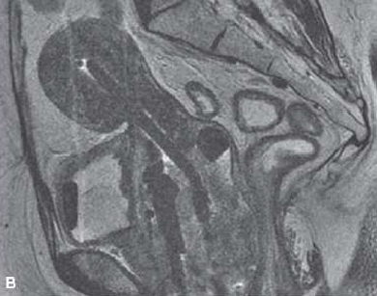
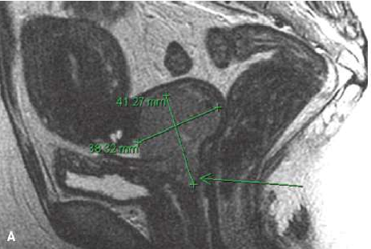
MRI
MRI is useful in providing accurate target Volume definition in brachytherapy treatment planning

Slide 16
Positron Emission Tomography
Squamous cell carcinoma is more often FDG avid than is adenocarcinoma.
Compared with Surgical staging, PET scanning had a sensitivity of 75% and a specificity of 92%
in detecting para-aortic metastasis.
Diagnostic PET images may be fused with simulation CT images to ensure accurate radiation dose coverage of the target and any PET-avid lymph nodes
After EBRT is finished, an FDG-PET scan provides important Information about post treatment uptake and is prognostic with regard to outcome

Slide 17
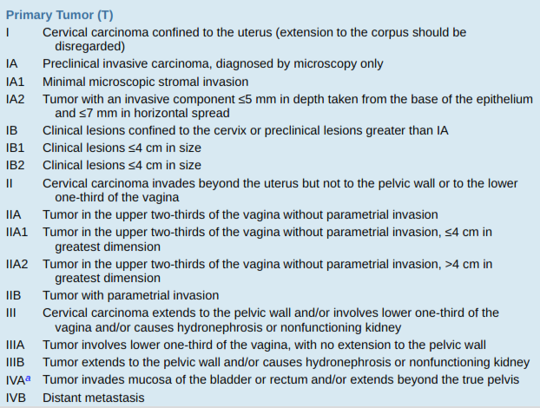
STAGING

Slide 18
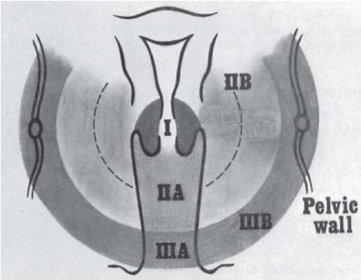
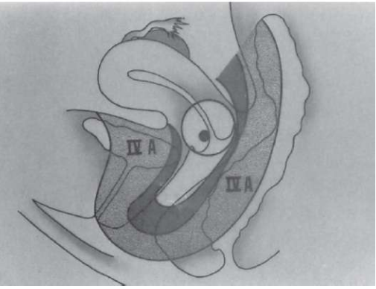

Slide 19
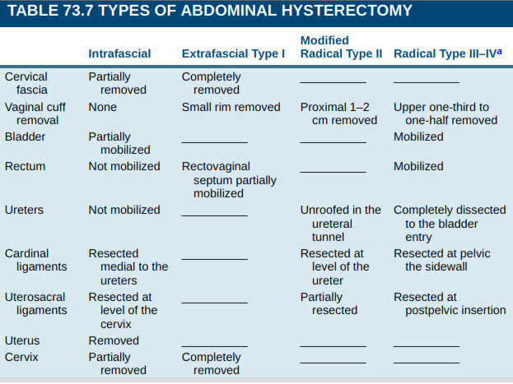
Surgical Techniques

Slide 20
GENERAL MANAGEMENT
Patients should be treated with close collaboration between the gynecologic oncologist and the radiation oncologist, and an integrated team approach should be vigorously pursued.
In countries with access to RT facilities and financial resources to supply chemotherapy, the use of concurrent chemoRT represents the accepted standard for patients with stage IB2 to IVA cervical
cancer.
For earlier-stage patients, the use of either surgery or chemoRT is recommended.

Slide 21
Preoperative Chemoirradiation
Bulky endocervical tumors and the so-called barrel-shaped cervix have a higher incidence of central recurrence, pelvic and PALN metastases, and distant
dissemination.
When using plain x-ray point-based planning for
brachytherapy,because of the inability of intracavitary sources to encompass the entire tumor in a high-dose volume, larger doses of external radiation to the
whole pelvis, extrafascial hysterectomy, or both have been advocated to improve therapeutic result

Slide 22
Preoperative Chemoirradiation
Alternatively, the use of 3D planning for the brachytherapy component significantly improves survival, and the ability to dose escalate because of a more precise dose delivery improves local control.

Slide 23
Preoperative Chemoirradiation
In rare cases With large residual after 45Gy external beam,an Extrafascial hysterectomy may be considered 6 to 12 weeks after completion of preoperative irradiation (45 Gy to the whole pelvis and one intracavitary LDR insertion for 5,500 mgh,
Delivering approximately 50 Gy to point A,with a total dose to point A of 70Gy, or the equivalent dose in HDR, approximately three fractions of 6 Gy per
fraction).
Higher doses of irradiation alone yield equivalent pelvic tumor control And survival rates.

Slide 24
Preoperative Chemoirradiation
The use of PET scanning to determine residual disease allows selection of patients who may be appropriate candidates for a hysterectomy after
completion of external beam treatment
Therefore, patients should receive definitive doses of chemoradiation, with hysterectomy reserved for salvage in patients with either gross residual disease or PET-positive disease that is biopsy proven at 3 months after completion of radiation.

Slide 25
Preoperative Chemoirradiation
A subsequent reanalysis including GOG 123 and GOG 71 analyzed 464 patients allocated to pelvic
radiation (75 Gy, n = 291) plus hysterectomy
or to pelvic radiation (75 Gy) and cisplatin (40 mg/m2
, n = 176) plus hysterectomy.
A benefit to chemoradiation Was seen for patients who had a poor response.

Slide 26
Preoperative Chemoirradiation
reported a randomized trial of 61 patients treated with
Adjuvant hysterectomy versus none after EBRT with concurrent weekly cisplatin and vaginal brachytherapy (15 Gy to intermediate-risk CTV) for stage IB2 or II cervical cancer.
Hysterectomy increased the number of deaths, with an 11% nonsignificant survival advantage in the no-hysterectomy arm (86% vs. 97%).
As a result of this trial, routine adjuvant hysterectomy is no longer practiced for patients who have no residual disease at 6 weeks after chemoradiation.

Slide 27
Preoperative Chemoirradiation
retrospectively reviewed 171 patients treated with
chemoradiation followed by simple extrafascial hysterectomy or extended hysterectomy.
There was no difference in survival or complication rate based on type of surgery.

Slide 28
Preoperative Chemoirradiation
reported on 111 patients treated with or without adjuvant hysterectomy after chemoradiation;
there was no advantage to Overall survival,
but there was a significant difference in recurrence rates.

Slide 29
Preoperative Chemoirradiation
Reported on toxicities for 150 patients with stageIB2 to IVA
Cervical cancers treated at IGR with extrafascial versus
modified radical hysterectomy after chemoradiation.
After a median follow-up of 3.6 years, 15% had grade 2 or greater side effects, including lymphedema, ureteral fistula, bowel fistula, and iliac and vessel rupture.
There were two postoperative deaths.
Modified radical versus extrafascial hysterectomy had a
higher odds ratio (OR) for complications of 2.4 (P = .04), as did the presence of residual disease.

